Slide 1
Distributed Computation of the Mode
Fabian Kuhn
Thomas Locher
ETH Zurich, Switzerland
Stefan Schmid
TU Munich, Germany
TexPoint fonts used in EMF.
Read the TexPoint manual before you delete this box.: AAAAAAAA

Slide 2
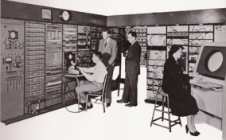
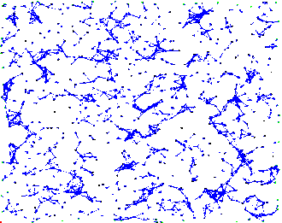




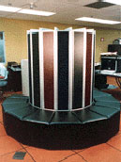

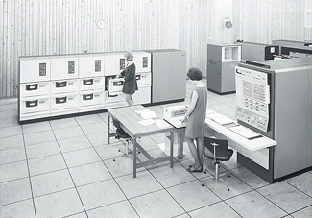
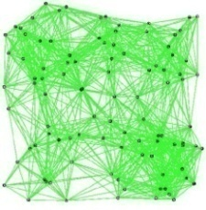

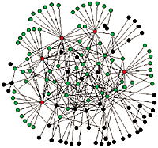

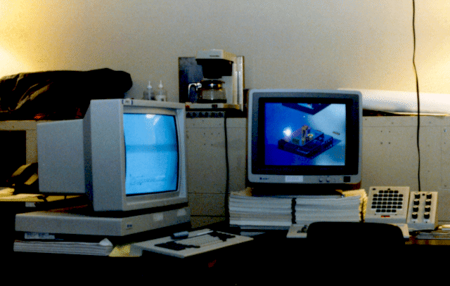











General Trend in Information Technology
Centralized
Systems
Networked
Systems
Large-scale
Distributed Systems
Internet
New Applications and
System Paradigms

Slide 3
Distributed Data
Earlier: Data stored on a central sever
Today: Data distributed over network
(e.g. distributed databases, sensor networks)
Typically: Data stored where it occurs
Nevertheless: Need to query all / large portion of data
Methods for distributed aggregation needed

Slide 4
Model
Network given by a graph G=(V,E)
Nodes: Network devices, Edges: Communication links
Data stored at the nodes
  For simplicity: each node has exactly one data item / value
Query initiated at some node
Compute result of query by sending around (small) messages

Slide 5
Simple Aggregation Functions
Simple aggregation functions: 1 convergecast on spanning tree
(simple: algebraic, distributive e.g.: min, max, sum, avg, …)
On BFS tree: time complexity = O(D) (D = diameter)
k independent simple functions:
Time O(D+k) by using pipelining

Slide 6
The Mode
Mode = most frequent element
Every node has an element from {1,…,K}
k different elements e₁,…,e_{k}, frequencies: m₁ ¸ m₂ ¸ … ¸ m_{k}
(k and m_{i} are not known to algorithm)
Goal: Find mode = element occuring m₁ times
Per message: 1 element, O(log n + log K) additional bits

Slide 7
Mode: Simple Algorithm
Send all elements to root, aggregate frequencies along the way
Using pipelining, time O(D+k)
  Always send smallest element first to avoid empty queues
For almost uniform frequency distributions, algorithm is optimal
Goal: Fast algorithm if frequency distribution is good (skewed)

Slide 8
Mode: Basic Idea
Assume, nodes have access to common random hash functions
h₁, h₂, … where h_{i}: {1,…,K} → {-1,+1}
Apply h_{i} to all elements:
element e₁, h_{i}(e₁)=-1
element e₂, h_{i}(e₂)=+1
element e₃, h_{i}(e₃)=+1
element e₄, h_{i}(e₄)=-1
element e₅, h_{i}(e₅)=-1
h_{i}
…
-1
+1
…
m₄
m₁
m₅
m₃
m₂

Slide 9
Mode: Basic Idea
Intuition: bin containing mode tends to be larger
Introduce counter c_{i} for each element e_{i}
Go through hash functions h₁, h₂, …
Function h_{j}: Increment c_{i} by number of elements in bin h_{j}(e_{i})
Intuition: counter c₁ of mode will be largest after some time

Slide 10
Compare Counters
Compare counters c₁ and c₂ of elements e₁ and e₂
If h_{j}(e₁) = h_{j}(e₂), c₁ and c₂ increased by same amount
Consider only j for which h_{j}(e₁) h_{j}(e₂)
Change in c₁ – c₂ difference:
where

Slide 11
Counter Difference
Given indep. Z₁, …, Z_{n}, Pr(Z_{i}=®_{i})=Pr(Z_{i}=-®_{i})=1/2
Chernoff:
H: set of hash function with h_{j}(e₁) h_{j}(e₂), |H|=s

Slide 12
Counter Difference
is called the 2nd frequency moment
Can make the same for all other counters:
If h_{j}(e₁) h_{j}(e_{i}) for s hash fct.:
h_{j}(e₁) h_{j}(e_{i}) for roughly 1/2 of all hash functions
After considering O(F₂/(m₁–m₂)²¢log n) hash functions:
→ c₁ largest counter w.h.p.

Slide 13
Distributed Implementation
Assume, nodes know hash functions
Bin sizes for each hash function: time O(D) (simply a sum)
Update counter in time O(D) (root broadcasts bin sizes)
We can pipeline computations for different hash functions
Algorithm with time complexity:
… only good if m₁-m₂ large

Slide 14
Improvement
Only apply algorithm until w.h.p., c₁ > c_{i} if m₁ ¸ 2m_{i}
Time:
Apply simple deterministic algorithm for remaining elements
#elements e_{i} with m₁ ¸ 2m_{i}: at most 4F₂/m₁²
Time of second phase:

Slide 15
Improved Algorithm
Many details missing (in particular: need to know F₂, m₁)
Can be done (F₂: use ideas from [Alon,Matias,Szegedy 1999])
If nodes have access to common random hash functions:
Mode can be computed in time

Slide 16
Random Hash Functions
Still need mechanism that provides random hash functions
Select functions in advance (hard-wired into alg):
→ algorithm does not work for all input distributions
Choosing random hash function h : [K] → {-1,+1} requires sending O(K) bits
→ we want messages of size O(log K + log n)

Slide 17
Quasi-Random Hash Functions
Fix set H of hash functions s.t. |H|= O(poly(n,K)) such that H satisfies a set of uniformity conditions
Choosing random hash function from H requires only
O(log n + log K) bits.
Show that algorithm still works if hash functions are from a set H that satisfies uniformity conditions

Slide 18
Quasi-Random Hash Functions
Possible to give a set of uniformity conditions that allow to prove that algorithm still works (quite involved…)
Using probabilistic method:
Show that a set H of size O(poly(n,K)) satisfying uniformity conditions exists.

Slide 19
Distributed Computation of the Mode
Lower bound based on generalization (by Alon et. al.) of set disjointness communication complexity lower bound by Razborov
Theorem: The mode can be computed in time O(D+F₂/m₁²¢log n) by a distributed algorithm.
Theorem: The time needed to compute the mode by a distributed algorithm is at least Ω(D+F₅/(m₁⁵¢log n)).

Slide 20
Related Work
Paper by Charikar, Chen, Farach-Colton:
Finds element with frequency (1-²)¢m₁ in a streaming model with a different method
It turns out:
  Basic techniques of Charikar et. al. can be applied in distributed case
  Our techniques can be applied in streaming model
  Both techniques yield same results in both cases

Slide 21
Conclusions:
Obvious open problem:
Close gap between upper and lower bound
We believe: Upper bound is tight
Proving that upper bound is tight would probably also prove a conjecture in [Alon,Matias,Szegedy 1999] regarding the space complexity of the computation of frequency moments in streaming models.

Slide 22
Questions?

